Slide 1
Open Source Project Presentation
December 2nd, 2015
Jerry Zhang, Kevin Chan, Quentin Fu
Team 38 - CPEN 321
A Tower Defense Game

Slide 2
Overview
Project description:
Game interface improvement
Tower diversification
Enemy diversification
Utilized methodologies
Informal Scrum
Pair programming
Requirements elicitation
User stories and scenarios

Slide 3
Game Interface Improvement
Objective
Implement a central menu for multi-difficulty setting selection
Improve the graphics of the game
Diversity tower beds and allowing for autonomous creativity

Slide 4

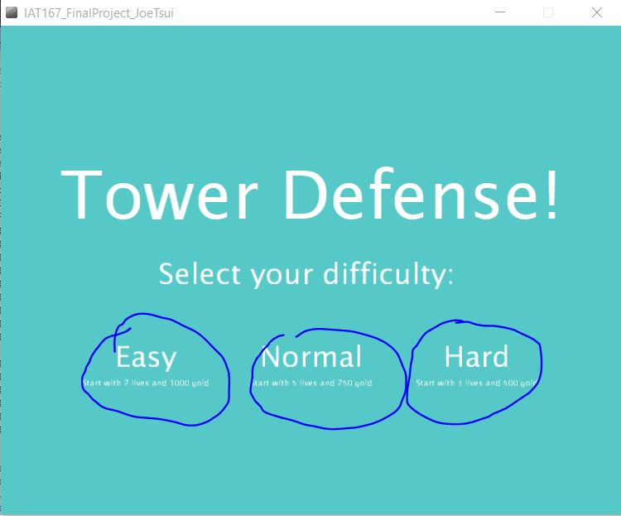

Slide 5
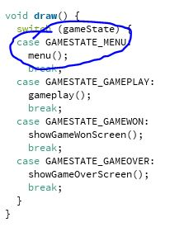
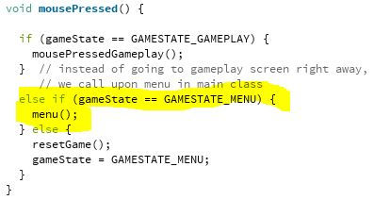
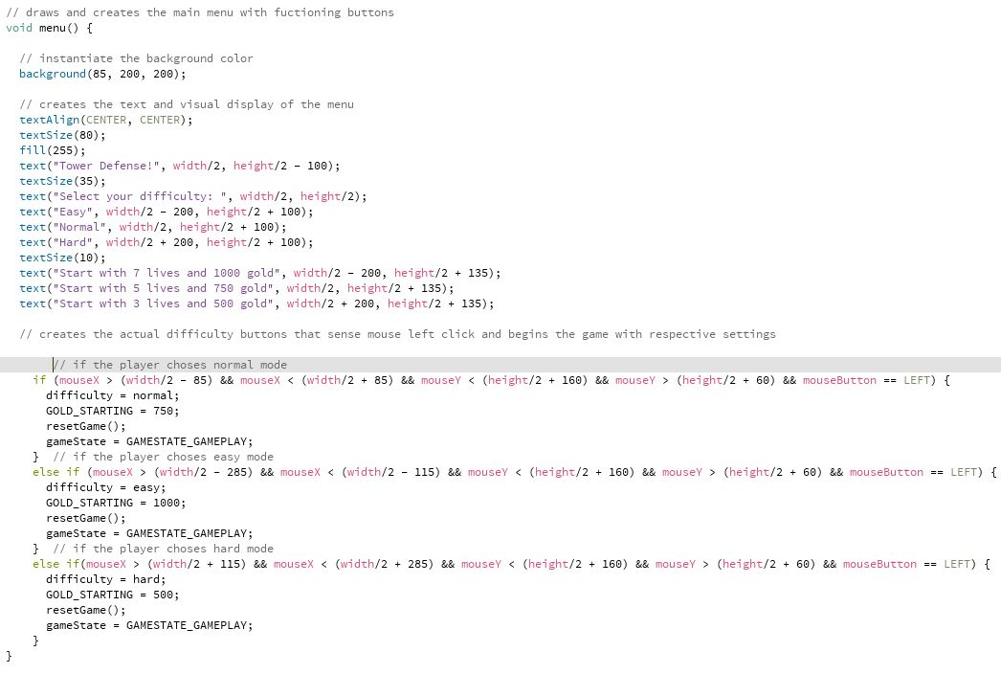

Slide 7
Tower Diversification
Objective
Implemented secondary tower upgrade options
Added laser, arrow, cripple and manual targeting towers

Slide 8
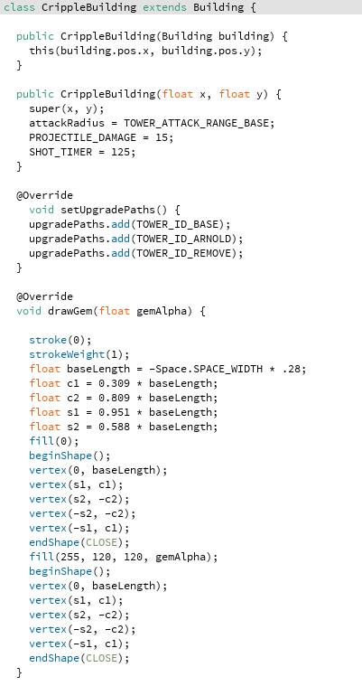
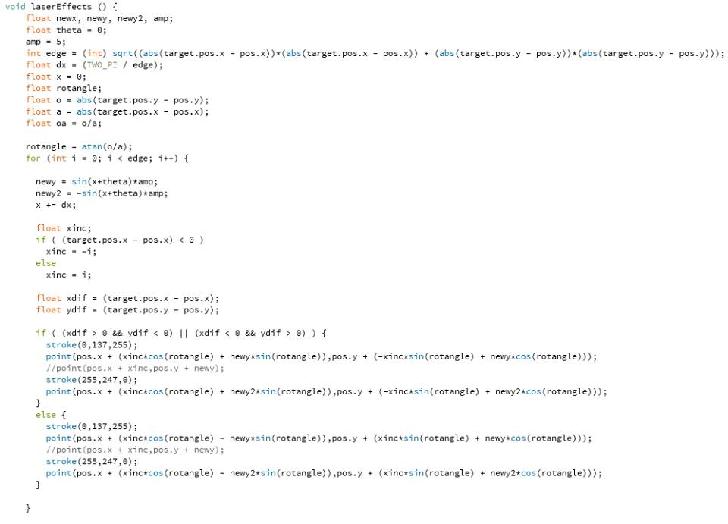

Slide 9
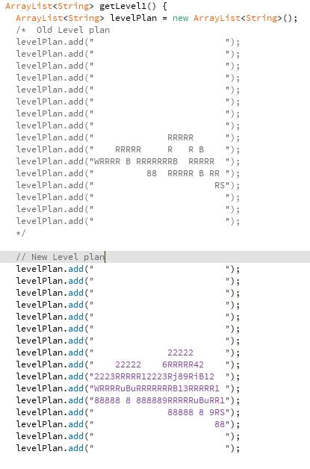
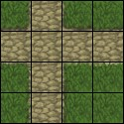

Slide 10
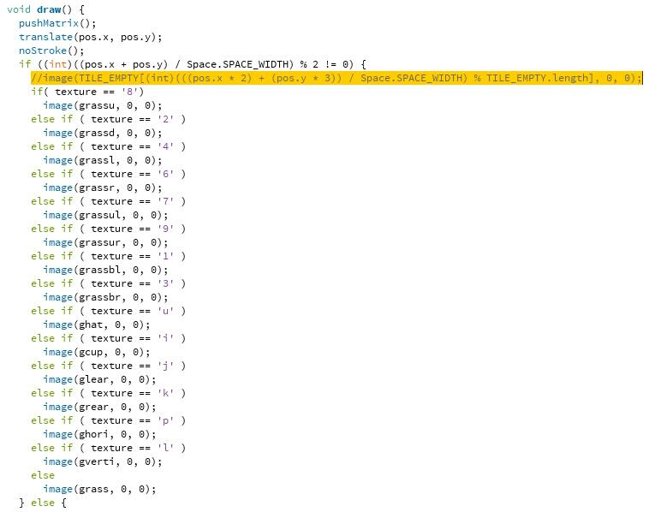

Slide 11
Enemy Diversification
Objectives
Added four new types of enemies
Each producing different gold drops and health rates

Slide 12
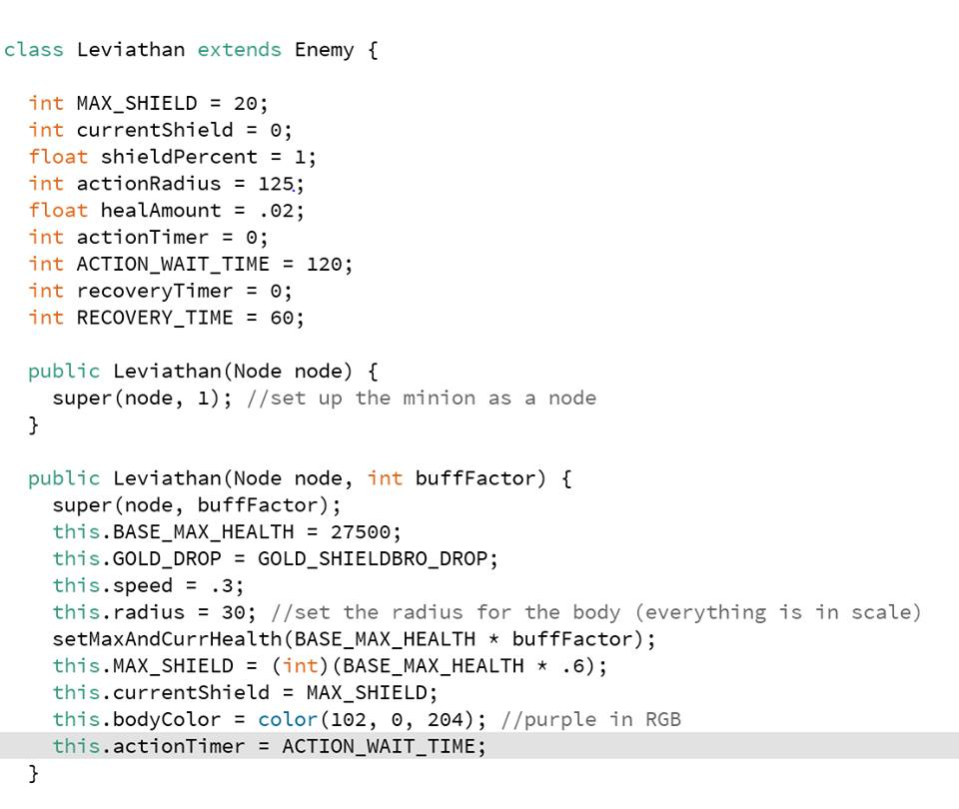

Slide 13
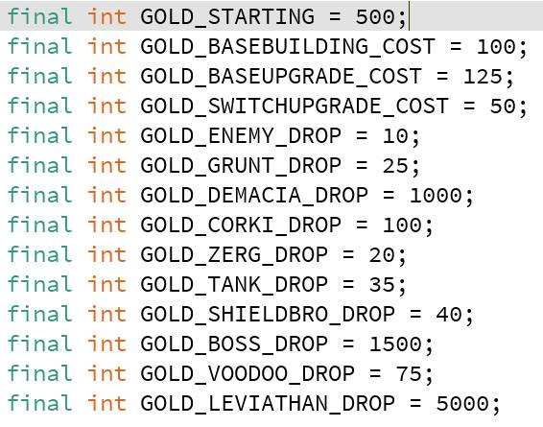

Slide 14
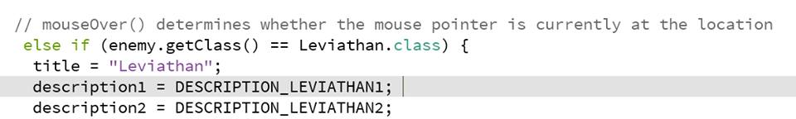
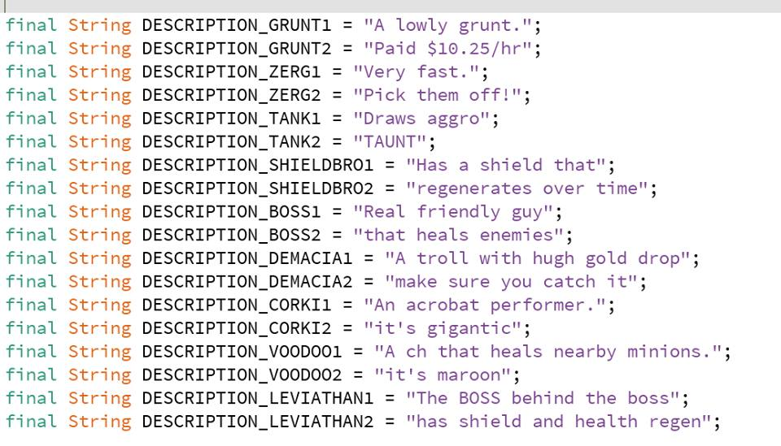

Slide 15
Procedure / Methodology
Procedure:
1. Discuss the requirements of this project
2. Elicitate requirements from other people
3. User stories formation
4. Flexible scrum meetings throughout the weeks
5. Pair programming
6. Repeat from step 4 until game works according to user stories
Tools
Processing
Github
Key assumptions
The game framework runs on a state machine structure
The maps are implemented much like JPacman with characters representing elements

Slide 16
Conclusion
More versatile game
Better graphics
Central menu

Slide 17
Questions & Discussion
Thanks for listening!

